Slide 1
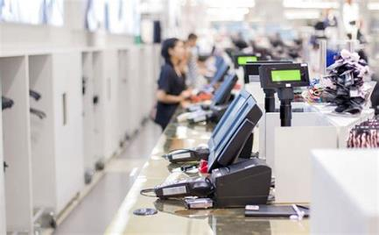

Slide 2
What is the St@rt Programme?
The St@rt Programme was devised by Greatest Expectations to support both local business and the community to help support our learners into paid employment with a wage contribution scheme, administered by Greatest Expectations Ltd.
Learners complete a qualification linked to the sector they want work in, generally at Level 1, however we do deliver courses starting at Level 2.
Maths, English and ITC are embedded within all courses to attain at least Level 1 and progression to Level 2
All learners, if the they fully complete the course, will have a guaranteed interview by the employer/s linked to the course
If they are successful in the interview and offered employment via the employer Greatest Expectations will contribute up to ten weeks to their wage equivalent to 16 hrs at minimum wage.

Slide 3
Can any employer become a partner of the St@rt Programme?
Yes, any employer can be part of the St@rt Programme, however we need to be sure that employers ‘buy into’ the aims of the St@rt Programme partners.
The St@rt Programme is a vehicle to support learners to embed their training whilst in paid employment and gain further skills and experience
The St@rt Programme is committed to progressing people in the workplace, so as part of the employment phase, we ask for four hours back, so we can upskill the employees every Monday, either morning or afternoon, in additional training based in the workplace at Level 2.
The remaining 12 hours will be timetabled to suit the employer
It is hoped the St@rt Programme employee is considered after the end of the wage contribution period pay for further employment, however it can be agreed with us the employee will leave after the ‘fixed term contract’.
The employee will still gain invaluable paid work experience for the fixed term period giving them the confidence, belief and motivation to apply and gain sustained employment.

Slide 4
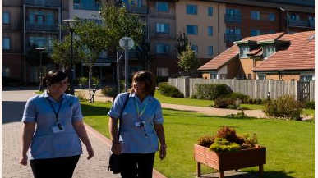
What are the benefits for the learner in joining the St@rt Programme?
The chance of employment, not handed to them, but earned after attendance on the course and passing an interview stage.
Giving St@rt Programme employees the opportunity to embed the learning in real world employment scenarios including receiving a wage and understand the financial as well as social benefits of work.
Additional work based accredited qualifications that can only be completed when they are employed
Even those St@rt Programme employees who will complete the fixed term contract period will by having up to date and relevant experience on their CV’s, with an employer who can provide a reference.
Those who are not employed will not be left behind, we will continue to work with them to build on the qualifications and skills completed.
Attendees benefit from increased confidence, social skills and further development opportunities to help them into long term sustainable employment.
Ending the reliance on benefits long term, releasing their potential through the opportunities afforded to them and returning pride and self worth to the individual

Slide 5
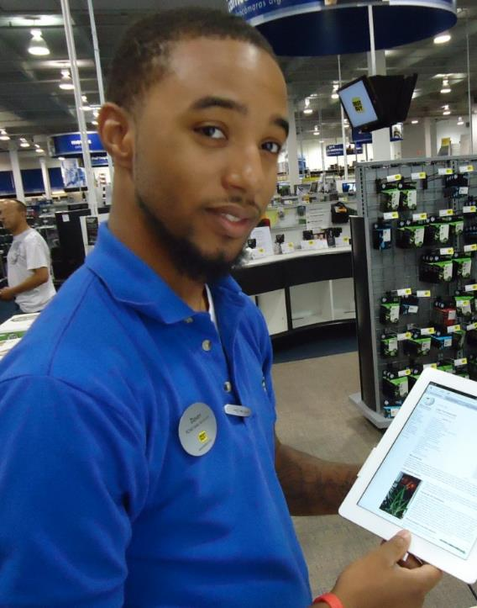
What are the benefits for the employer in joining the St@rt Programme partnership
Employers can help and support those who are finding it difficult to get into work due to long term unemployment, skills gaps or lack of accredited qualifications.
A no risk ‘try before you buy’ to recruitment, embedding the St@rt Programme into your recruitment process, means that we can give up to date training which can be bespoke to an individual business, to meet short or long term recruitment needs.
Free resource in respect of the funded period of employment for up to 10wks paid at minimum wage employed for 16hrs per week.
Business’s who require additional staff but cannot afford it due to financial constraints, especially small independents or sole trader companies.
Short term cover for staff who are not able to work i.e. long term health related issues or maternity or paternity leave who are still paid whilst absent from work
The opportunity to upskill your current staff in a variety of qualifications from sector specific to more specialist e.g. team leading at no cost

Slide 6
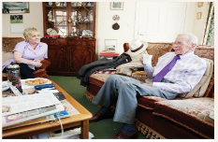
What training is available on the St@rt Programme?
Customer Service Health & Social Care Warehouse
Catering & Hospitality Childcare Retail

Slide 7
The St@rt Programme: Enterprise and Self Employment The Start Programme also supports start ups and new business programs by supporting with grants and sector specific accredited training courses. The St@rt Programme can help ease some of the financial burden with small grants or provide you with much needed extra pairs of hands employed by you, taking advantage of the wage contribution scheme. Opportunities include Beauty & Make Up (In association with Total Academy) Home Retail (In Association with Body Shop at Home / Avon) Multi Drop Drivers (In Association with Yodel) Taxi Drivers (In Association with Boro & 23 Taxis) Handy Man (TBC) Childminding (TBC) In addition to accredited training you will also be eligible for a grant for start up equipment and additional Business Support around Digital Marketing and support with accounts. We recommend that those wishing to take advantage of the Enterprise and Self Employment who are currently in receipt of benefits speak to their work coach, as their maybe further financial help available.

Slide 8
Flexible Learning and Upskilling New and Current Employees
Due to changes in the funding rules the St@rt Programme can not only fund the unemployed but also the Employed and the Underemployed. Regardless if you are full time part time or a zero/bank worker the St@rt Programme can support you to gain further accredited qualifications that can lead to sustainable long term full time employment.
Those employers that join the St@rt Programme can also take advantage of upskilling their current staff, at no charge, in a variety of different qualifications from Team Leading to Excellence in Customer Service and Autism Awareness to Mental Health awareness and many more.
Upskilling your employees shows your commitment their progression and promotion, within your business, underpins their CPD and embeds staff retention.

Slide 9
Contacting the St@rt Programme
Contact the St@rt Programme
01642 22077
m.cummins@greatestexpectations.co.uk
079 56 49 56 49

