Slide 1


Including the
Wage Contribution Scheme
Administered by
Greatest Expectations Ltd

Slide 2
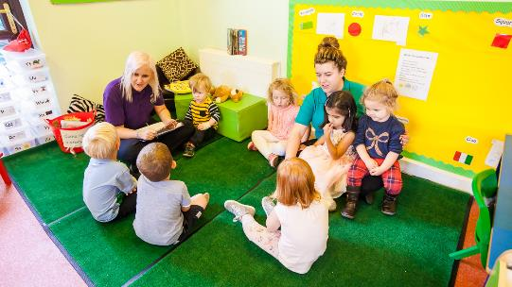
What is the St@rt Programme?
The St@rt Programme was devised by Greatest Expectations to support both local business and the community to help support our learners into paid employment with a wage contribution scheme, administered by Greatest Expectations Ltd.
Learners complete a qualification linked to the sector they want work in, generally at Level 1, however we do deliver courses starting at Level 2.
Maths, English and ITC are embedded within all courses to attain at least Level 1.
All learners, if the they fully complete the course, will have a guaranteed interview by the employer/s linked to the course
If they are successful in the interview and offered employment via the employer Greatest Expectations will contribute up to ten weeks to their wage equivalent to 16 hrs at minimum wage.

Slide 3

Can any employer become a partner of the St@rt Programme?
Yes, any employer can be part of the St@rt Programme, however we need to be sure that employers ‘buy into’ the aims of the St@rt Programme partners.
The St@rt Programme is a vehicle to support learners to embed their training whilst in paid employment and gain further skills and experience
The St@rt Programme is committed to progressing people in the workplace, so as part of the employment phase, we ask for four hours back, so we can upskill the employees every Monday, either morning or afternoon, in additional training based in the workplace at Level 2.
The remaining 12 hours will be timetabled to suit the employer
It is hoped the St@rt Programme employee is considered after the end of the wage contribution period pay for further employment, however it can be agreed with us the employee will leave after the ‘fixed term contract’.
The employee will still gain invaluable paid work experience for the fixed term period giving them the confidence, belief and motivation to apply and gain sustained employment.

Slide 4
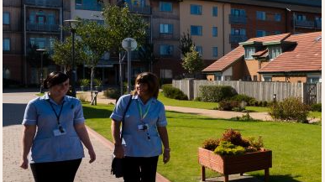
What are the benefits for the learner in joining the St@rt Programme?
The chance of employment, not handed to them, but earned after attendance on the course and passing the interview stage.
Giving St@rt Programme employees the opportunity to embed the learning in real world employment scenarios including receiving a wage and understand the financial as well as social benefits of work.
Additional work based accredited qualifications that can only be completed when they are employed
Even those St@rt Programme employees who will complete the fixed term contract period will benefit by having up to date and relevant experience on their CV’s, with an employer who can provide a reference.
Those who are not employed will not be left behind, we will continue to work with them to build on the qualifications and skills completed.
Attendees benefit from increased confidence, social skills and further development opportunities to help them into long term sustainable employment.
Ending the reliance on benefits long term, releasing their potential through the opportunities afforded to them and returning pride and self worth to the individual

Slide 5
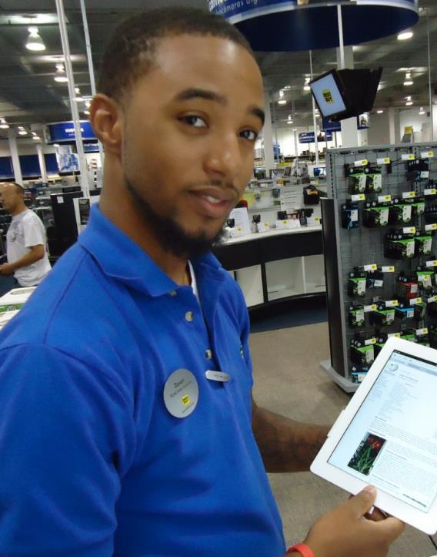
What are the benefits for the employer in joining the St@rt Programme partnership
Employers can help and support those who are finding it difficult to get into work due to long term unemployment, skills gaps or lack of accredited qualifications.
A no risk ‘try before you buy’ approach to recruitment, embedding the St@rt Programme into your recruitment process, means that we can give up to date training which can be bespoke to an individual business, to meet short or long term recruitment needs.
Free resource in respect of the funded period of employment for up to 10wks paid at minimum wage employed for 16hrs per week.
Business’s who require additional staff but cannot afford it due to financial constraints, especially small independents or sole trader companies can offer employment at no cost to them.
Short term cover for staff who are not able to work i.e. long term health related issues or maternity or paternity leave who are still paid whilst absent from work
The opportunity to upskill your current staff in a variety of qualifications from sector specific to more specialist e.g. team leading at no cost

Slide 6

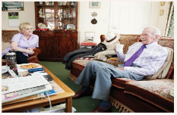

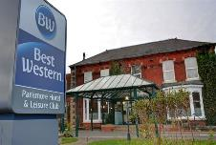


What training is available on the St@rt Programme?
Customer Service Health & Social Care Warehouse
Catering & Hospitality Childcare Retail

Slide 7


The St@rt Programme Wage Contribution Scheme SBWA Courses
Our Level 1 and Level 2 Customer Service Course covers a variety of sectors including
Retail – Short and Long Term recruitment solutions for retailers across the area.
Hospitality – Working with Employer partners in the food and drink sector including Cafes; Restaurants; Public Houses.
Front of House – Employers who require a receptionist / meet and greet including Hotels; Shops; Telephony services and appointment booking.
Enterprise Pathway – All our Self Employment opportunities are under pinned by our customer service training.
We have been delivering both Level 1 Introduction to Adult Social Care and Level 2 Preparing to Work in Health and Social Care training for local companies for over four years.
We have a comprehensive list supplementing qualifications at Level 2 including
Safe Guarding and Prevent; Awareness of Mental Health and Dementia; Working with Individuals with Behaviour that Challenges and Learning Difficulties; Infection Prevention and Control; Health and Safety in Health and Social Care

Slide 8
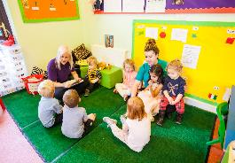

The St@rt Programme Wage Contribution Scheme SBWA Courses cont/
With a wealth of experience in the Childcare sector, gained through Great Expectations Day Nursery adjacent to our training premises in Middlesbrough our Childcare SBWA’s are founded on a solid background in understanding the Childcare sectors needs.
We deliver Level 1 Introduction to the Children and Young People Workforce as a starting point progressing to Level 2 Childcare certificates including Autism Awareness; Safe Guarding and Prevent; Identifying Childhood illnesses.
As a trusted childcare employer we have a good network relationship with other childcare providers across the Tees Valley.
We are always looking for new partners who can compliment our current partnership network and we welcome speaking to businesses across the Tees Valley.
We constantly develop our network of employers and listen to their needs as well as looking to develop other wage contribution courses. We are actively seeking partners in the Business Administration, Automotive, and Team Leading and Management sectors as well as currently developing a training programme focusing on Digital Marketing for Business.

Slide 9
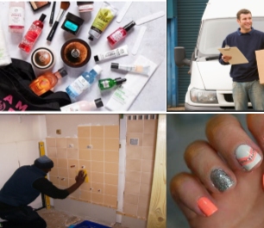
The St@rt Programme: Enterprise and Self Employment
The Start Programme supports start ups and new business programs with grants and sector specific accredited training courses, including business support after start up.
The St@rt Programme can help ease some of the financial burden with small grants or provide you with much needed extra pair of hands, taking advantage of the wage contribution scheme for sole traders / small companies.
Self Employed Pathways Include
Beauty & Make Up
Home Retail
Multi Drop Drivers
Taxi Drivers
Handy Man
Childminding
In addition to accredited training you will also be eligible for a grant for start up equipment and additional Business Support around Digital Marketing and support with accounting.
We recommend that those wishing to take advantage of the Enterprise and Self Employment pathways, who are currently in receipt of benefits speak to their work coach, as their maybe further financial help available.

Slide 10

Flexible Learning and Upskilling New and Current Employees
Due to changes in the funding rules the St@rt Programme can not only fund the Unemployed but also the Employed and the Underemployed. Regardless if you are full time part time or a zero/bank worker the St@rt Programme can support you to gain further accredited qualifications that can lead to sustainable long term full time employment.
Those employers that join the St@rt Programme can also take advantage of upskilling their current staff, at no charge, in a variety of different qualifications from Team Leading to Excellence in Customer Service and Autism Awareness to Mental Health awareness and many more.
Upskilling your employees shows your commitment to their progression and promotion, within your business, underpinning their CPD embeding staff retention.

Slide 11
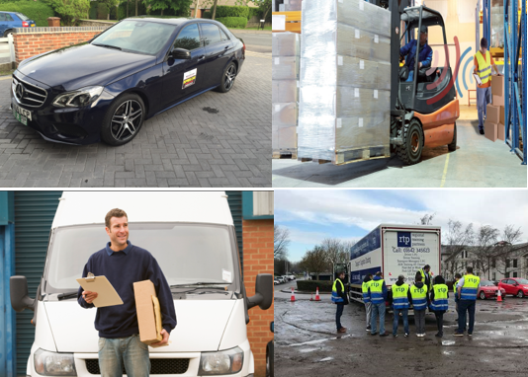
Driver Training* with the St@rt Programme
LGV/HGV – Working with National Haulage Association to address the immediate needs of the haulage sector, we deliver a 13 week course to get on the road and start work in this sector providing you complete the course and pass your funded Cat C Licence, Theory and Test, Medical, CPC, and Tachograph all funded by GE Ltd; over £1800 worth of training.
Taxi Private Hire – Not only do Drivers achieve a BTEC and complete mandatory Passenger Disability Awareness but also all medicals, badges, tests and licences are funded.
Hackney – Learners must have had experience in a Private Hire role. Drivers will complete the Road Passenger Vehicle Driving Certificate but also the cost for the Hackney Badge will be met by Greatest Expectations.
Fork Lift Truck – Completing the Warehousing 6 week Pathway will see an Accredited Warehouse qualification but also a Reach & Counterbalance Licence and also pallet truck training.
Van Delivery – We will soon be offering a further driver training package around multi-drop van delivery. The course will include accredited training in delivering goods by road, driver CPC and Test and Theory if you passed your test after 1994.
* Completion of these courses do not qualify for the wage contribution scheme due to the cost of associated licences and tests

Slide 12

Contacting the St@rt Programme
Contact the St@rt Programme
01642 220777
m.cummins@greatestexpectations.co.uk
079 56 49 56 49

